Slide 1
predictive product leakage

Slide 2

Danang hapis fadillah
Graduated Machine Learning Cohort - Bangkit Academy led by Google, Tokopedia, Gojek, & Traveloka
Google Developer Student Club Universitas Indonesia
Web Developer at Fiverr since 2022
GEMASTIK 2024 at Data Mining Field

Slide 3

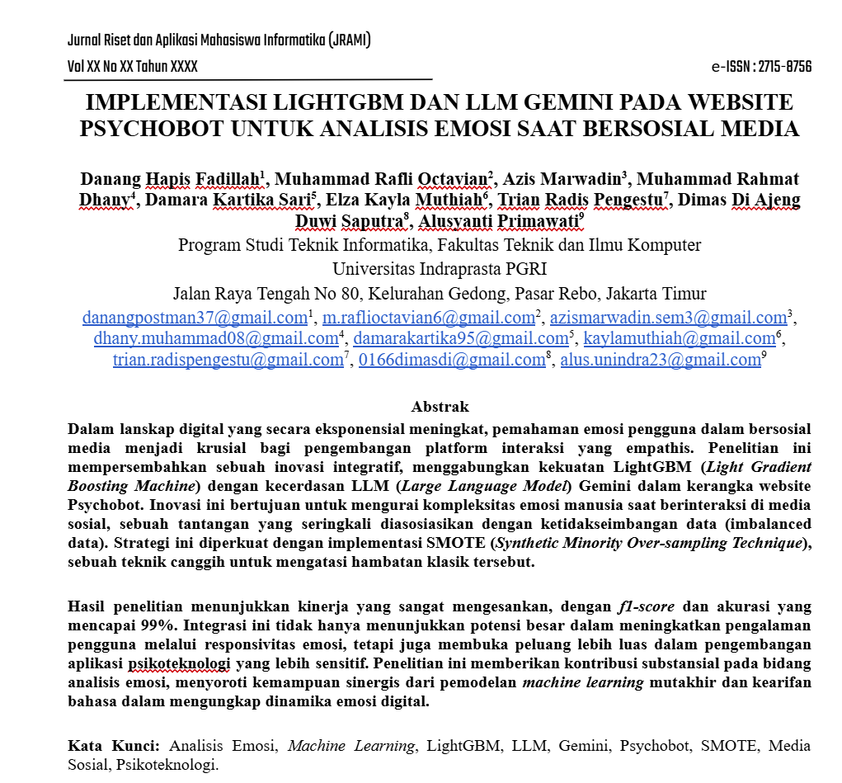
The last activity
InterSim AI
Our Journal about Psychology and AI

Slide 4
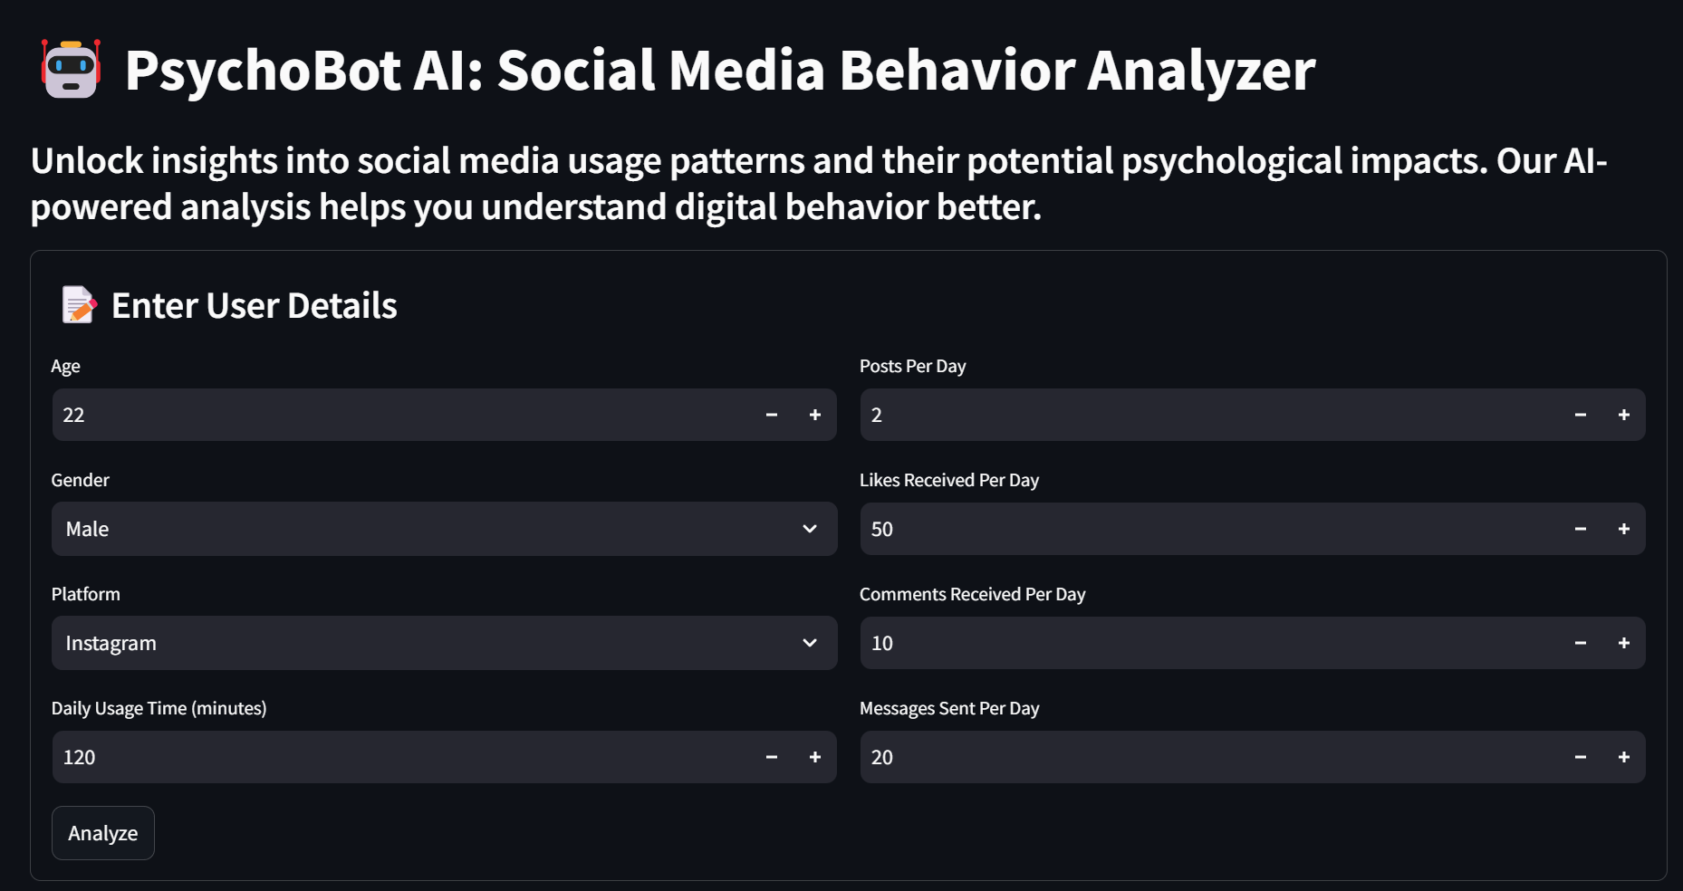

Slide 5
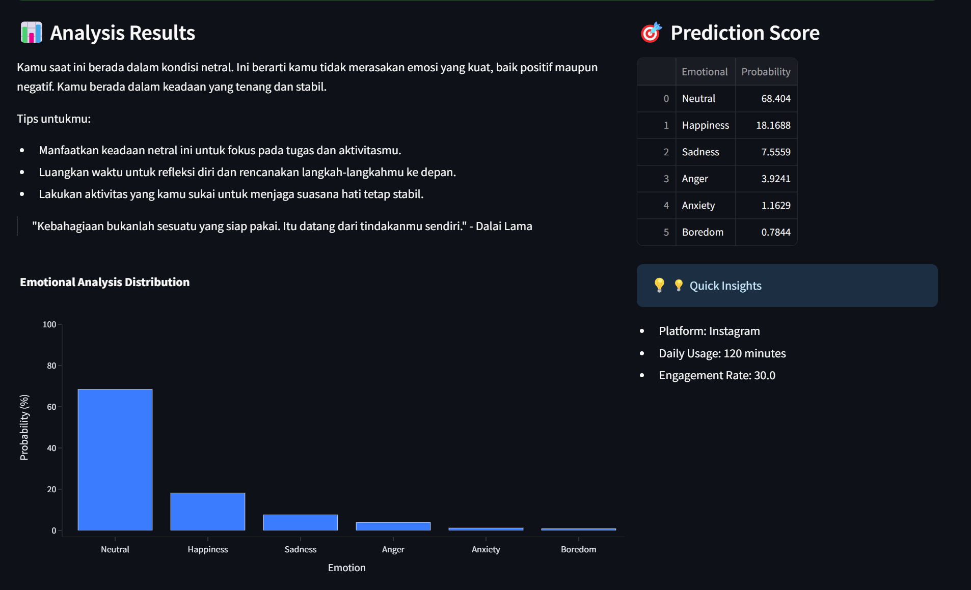

Slide 6

Psychobot ai

Slide 7
AGENDA
Common Causes of Product Leaks
Why Use Machine Learning?
What Data Needed to Build Machine Learning Model?
Data Preprocessing
Workflow

Slide 8
Common Causes of Product Leaks
Material packaging failure
Errors in the production process (for example imperfect sealing)
Imbalance of liquid volume in packaging

Slide 9

Preventing Using Machine Learning

Slide 10
Why Use Machine Learning?
What are the benefits of implementing Machine Learning?
Automatic and real-time leakage detection
Increased efficiency and accuracy compared to manual methods
Minimizing defective products and reducing production costs

Slide 11
What Data Needed to Build Machine Learning Model?

Slide 12
Sensor Data and preprocessing Techniques
Required Data Types:
Data Preprocessing Steps:
Datetime → Timestamp from start to end while production process
Temperature Sensor → Detects temperature changes that may affect packaging
-
-
-
Classification Data → Labels data for product condition (whether it is leaking or not) (yes/no)
Data Collection
Data Normalization
Features Extraction
Splitting data for training and testing (80% training, 20% testing)

Slide 13


Production pipeline
Sensor A
Sensor C
Sensor A = 2
Sensor B = 6
Sensor C = 9
class
no
no
yes
BOCOR?
Sensor B

Slide 14
Dataset look like
Nama Produk | Sensor Tekanan | Sensor Suhu | Datetime | class
Komix | 1 | 1 | 2/15/2025 7:00 | no
Bejo | 2 | 2 | 2/15/2025 8:00 | no
Komix | 3 | 3 | 2/15/2025 9:00 | yes
Features (X)
Target (y)
Label leakage (y/n)
Factors that affect product leakage

Slide 15
“ A good model comes from good data. “

Slide 16
Training & Eval phases
Model training with various algorithms
Model performance evaluation uses accuracy
ML Algorithms
XGBoost
LightGBM
SVM
Etc..

Slide 17

After Training Model What Should We Do?
Integration with control systems for automatic preventive measures
For Example:
Shutdown Automation
Turn On the Alarm
Adjusting a producing process

Slide 18
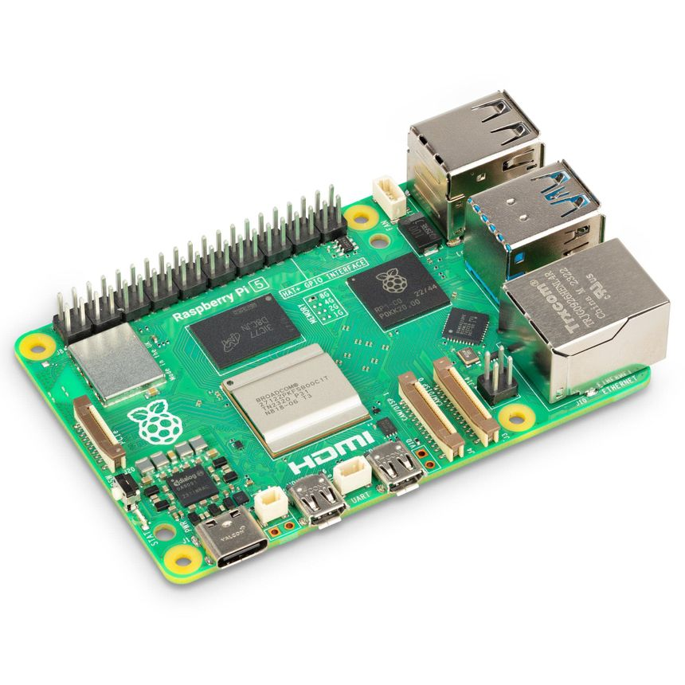
Workflow
Data Collection
Data Preprocessing
Exploratory Data Analysis (EDA)
Training Model
Bad Model
Raspberry Pi
Control System Integration (Inference)
Evaluation
Good Model

Slide 19
THANK YOU

Slide 20



Web App
LinkedIn
Email

